Slide 1
(CPR) Call Processing Record (Customer Record Administration folder)
Introduction
CPR Window
CPR Tasks
CPR Examples
SMS/800 ® is a registered trademark of SMS/800, Inc.
Notes:
CPR – Call Processing Record. Complex Records
(Click) Introduction
(Click) CPR window
(Click) CPR Tasks
(Click) CPR Examples

Slide 2
SMS/800 Course Roadmap
15 Reporting
12 CRA
11 ROP
7 LAD
13 Automation
6 CPR
10 ASL
14 Carrier
3 Introduction
8 TAD
4 NUS
2 Benefits
1 Welcome
9 TRQ
5 CAD
16 WEB
Mon.
Tue.
Fri.
Wed.
Thu.
Here You Are
Notes:
(Click) This course is a 5 day course. Monday we will cover the Welcome
(Click) , Benefits
(Click) , Introduction
(Click) , NUS (Reserving numbers
(Click) , and CAD (Building customer records
(Click) . Tuesday we will build Complex Records using the CPR
(Click) . Wednesday we will add Label definitions (LAD) to our complex routing
(Click) . Thursday we will cover several feature screens: TRQ
(Click) , ASL
(Click) , ROP
(Click) , CRA
(Click) , AUTOMATION
(Click) AND CARRIER
(Click) . Friday We will learn how to use the WRS Reporting System
(Click) and review the SMS/800 business website
(Click) . Let us begin…

Slide 3
Customer Records that Require a CPR
A customer record requires a CPR if any of the following conditions are true:
There is more than one intraLATA carrier.
There is more than one interLATA carrier.
There is more than one POTS destination number.
Vertical features, such as time-of-day routing, will be used for the Dial Number service.
Notes:
When is a CPR necessary?
(Click) A customer record requires a CPR if any of the following conditions are true:
(Click) If there is more than one intralata carrier
(Click) If there is more than one interlata carriers.
(Click) If there is more than one POTS destination number.
(Click) If Vertical features, (i.e. time of day, blocking, least cost multicarrier routing) are needed or desired.

Slide 4
Complex Call Routing – Basic Concepts
Calls to a Dial Number can be routed through several carriers and/or to several destination numbers.
Chicago\Milwaukee Example:
A Dial Number customer might request that from 9:00am to 5:00pm on Monday through Friday, all calls should be routed through carrier 1111 to an office in downtown Chicago. At all other times, calls to the same Dial Number should be routed through carrier 2222 to an office in Milwaukee.
Steps to create call routing scheme:
Draw a call routing diagram, to help clarify all of the relevant criteria for routing the calls.
Enter the call routing data in the CPR.
Notes:
Calls to a Toll Free number can be routed through several carriers and/or to several destination numbers.
(Click) Here is a Chicago\Milwaukee example:
(Click)
A Dial Number customer might request that from 9:00am to 5:00pm on Monday through Friday, all calls should be routed through carrier 1111 to an office in downtown Chicago. At all other times, calls to the same Dial Number should be routed through carrier 2222 to an office in Milwaukee.
(Click)
Steps to create the call routing scheme:
(Click) Draw a call routing diagram, to help clarify all of the relevant criteria for routing the calls.
(Click) Enter the call routing data in the CPR.
(Click)

Slide 5
Call Routing Diagram
There are two originating call Decisions that affect how calls are routed: Day-of-Week Time-of-Day
2. Once the conditions and decisions are made, there are two Actions that need to be determined: Carrier Tel#
Day
Time
Carrier
1111
2222
2222
Tel#
Notes:
Here is the Call Routing Diagram (Tree) for the example:
(Click)
(Click) There are two originating call Decisions that affect how calls are routed:
(Click) Day-of-Week
(Click) Time-of-Day
(Click)
Once the conditions and decisions are made, there are two Actions that need to be determined:
(Click) Carrier
(Click) Tel#
There are 3 branches to this Call Routing Diagram (TREE)
Branch 1 of the tree reads as follows:
(Click) When a call is made to 800-234-5678
(Click) On Monday through Friday
(Click) between 9:00am and 5:00pm
(Click) send the traffic to carrier 1111 and
(Click) Terminate at the POTS number 312-222-3333
Branch 2 of the Tree reads: On M-F all
(Click) OTHER times use carrier
(Click) 2222 and terminate at
(Click) 414-555-6666
(Click) OTHER days of the week are also sent to carrier 2222 to 414-555-6666

Slide 6
CPR for CR Diagram
Format = 9:00a-5:00p
Time Zone drop-down
Format = M, Tu, W, Th, F, Sa, Su
Notes:
After drawing out the Call Routing diagram Tree, the user puts the data into the CPR.
(Click)
At the top of the CPR are the Column Headers: Day, Time, Carrier, Tel#
(Click)
The first branch of the Tree is entered in the first data row of the CPR
(Click)
The Second branch of the Tree is entered in the 2nd data row of the CPR
(Click)
The Third branch of the Tree “all OTHER days” is entered in the 3rd roww of the CPR.
(Click)
The correct format for Days of the week are: M, Tu, W, Th, F, Sa, Su
(Click)
The correct time format is 9:00a-5:00p
(Click)
The default time zone for SMS/800 is Central. Other time zones can be selected in dropdown to the right of the column header.

Slide 7
Decision & Action Nodes (Criteria)
Eleven Decision Nodes (Criteria)
1 | State | States from which calls originate. (4 state codes only)
2 | Lata | Latas from which calls originate. (3 Latas)
3 | Area Code | Area codes from which calls originate. (3 Area Codes)
4 | NXX | NXXs from which calls originate. (3 NXXs)
5 | 6-digit | NPA-NXXs from which calls originate. (2 – 6#s)
6 | 10-digit | Pots number from which calls originate. (1 – 10#s)
7 | Date | Date(s) on which calls are made. (2 dates)
8 | Day | Day(s) on which calls are made. (4 days or range)
9 | Time | Time which calls are made. (range)
10 | Switch | Used to create Emergency routing (On or Off)
11 | Percent | Used to allocate a percentage of calls to different destinations.
Four Action Nodes (Criteria)
12 | Carrier | Carrier used to route calls.
13 | Tel# | The Destination telephone number.
14 | Announce | Used to Block calls (OBA or VCA)
15 | Goto | Used to reference a Sub Section
Notes:
There are a total of 15 possible Column headers or nodes that can be used on the CPR.
There are 11 Decision Nodes and
(Click)
Four action nodes
(Click)
The 11 Decision Nodes (Column Headers) include:
1. State - States from which calls originate. (4 state codes only)
2. Lata - Latas from which calls originate. (3 Latas)
3. Area Code - Area codes from which calls originate. (3 Area Codes)
4. NXX - NXXs from which calls originate. (3 NXXs)
5. 6-digit - NPA-NXXs from which calls originate. (2 – 6#s)
6. 10-digit - Pots number from which calls originate. (1 – 10#s)
7. Date - Date(s) on which calls are made. (2 dates)
8. Day - Day(s) on which calls are made. (4 days or range)
9. Time - Time which calls are made. (range)
10. Switch - Used to create Emergency routing (On or Off)
11. Percent - Used to allocate a percentage of calls to different destinations.
(Click)
There are Four action Nodes (Columns) that define what to do with the Decision Nodes.
(Click)
12. Carrier – Which carrier to use when a specific decision row is set up
(Click)
13. Tel# - The destination ring to number. Can be either Dial# or Pots.
(Click)
14. Announce – Used to Block calls (OBA out of Band) or VCA (Vacant code )
(Click)
15. GOTO - used to point to a Sub Section for routing instructions.

Slide 8
General Rules for Building CPRs - 1
Arrange decision nodes (criteria) in order (left to right) from general to specific, such as “State,AREA CD, 6#” rather than “6#, STATE, AREA CD”.
Avoid duplicating nodes (criteria) on the CPR (Except where necessary to specify different time zones). This increases the efficiency of the system’s query and lookup process.
A 6# node cannot be on the same CPR with an NXX node.
An NXX node must be preceded by an Area CD Node. (Exception = LAD)
In any case, we strongly recommend that you do not use NXX as the first node of a CPR and that you always place an AREA CODE node or LATA node before an NXX node. This improves the searching efficiency of the SMS/800 system when it comes time to query the SCPs.
A CPR can have both a TEL# and an ANNOUNCE node. However, on any given row (branch) of the CPR, only one of these nodes may be filled in; the other must be left blank.
Notes:
General Rules for Building CPRs (slide 1)
(Click)
1. Arrange decision nodes (criteria) in order (left to right) from general to specific, such as “State,AREA CD, 6#” rather than “6#, STATE, AREA CD”.
(Click)
2. Avoid duplicating nodes (criteria) on the CPR (Except where necessary to specify different time zones). This increases the efficiency of the system’s query and lookup process.
(Click)
3. A 6# node cannot be on the same CPR with an NXX node.
(Click)
4. An NXX node must be preceded by an Area CD Node. (Exception = LAD)
(Click)
5. In any case, we strongly recommend that you do not use NXX as the first node of a CPR and that you always place an AREA CODE node or LATA node before an NXX node. This improves the searching efficiency of the SMS/800 system when it comes time to query the SCPs.
(Click)
6. A CPR can have both a TEL# and an ANNOUNCE node. However, on any given row (branch) of the CPR, only one of these nodes may be filled in; the other must be left blank.
(Click)

Slide 9
General Rules for Building CPRs - 2
7. On any row (branch) of a CPR, the last node that is filled in with a value represents the termination of the call.
8. CARRIER, TEL#, ANNOUNCE cannot be the first node of a CPR.
9. On any row (branch) of a CPR, you cannot leave the first node (column) blank if there is any data in the rest of the row.
10. Both Percentage and Announcement cannot contain an entry on a single row of the CPR.
A CPR main section can not have more than 1000 rows nor more than 20 columns nor more than 600 Destination Numbers.
If the first column of the CPR is a 6-digit, 10-digit or NXX node, then the entire CPR has a 200 row limit .
Notes:
7. On any row (branch) of a CPR, the last node that is filled in with a value represents the termination of the call.
(Click)
8. CARRIER, TEL#, ANNOUNCE cannot be the first node of a CPR.
(Click)
9. On any row (branch) of a CPR, you cannot leave the first node (column) blank if there is any data in the rest of the row.
(Click)
10. Both Percentage and Announcement cannot contain an entry on a single row of the CPR.
(Click)
11. A CPR main section can not have more than 1000 rows nor more than 20 columns nor more than 600 Destination Numbers.
(Click)
12. If the first column of the CPR is a 6-digit, 10-digit or NXX node, then the entire CPR has a 200 row limit .
(Click)

Slide 10
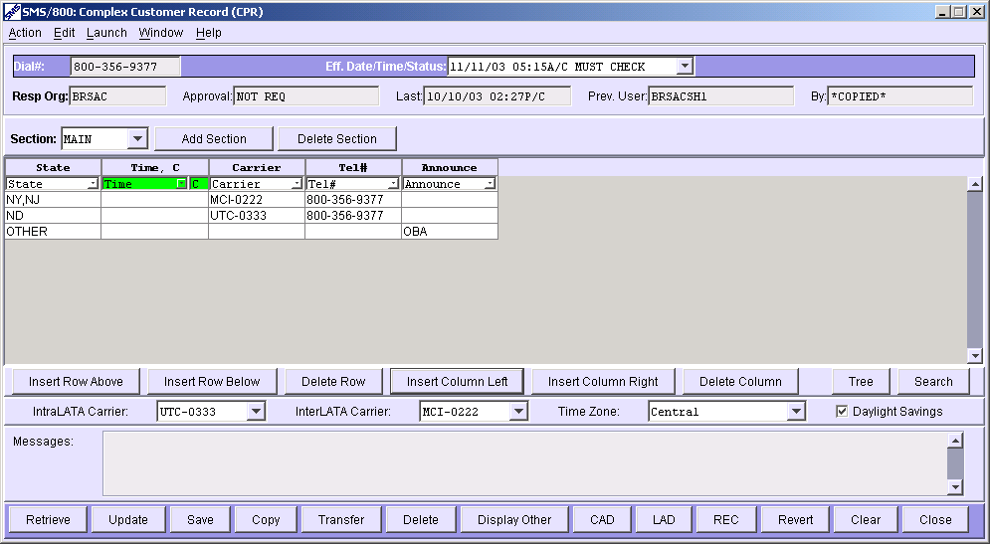
Complex Customer Record Window
1
2
3
Primary Carrier
Time Zone default
4
Notes:
Let us take a closer look at the CPR screen. I’ve divided it up into 4 parts.
(Click) (Click) (Click) (Click)
In the 4th section are two fields to enter the Primary Interlata or Intralata carriers.
(Click) if there is only one of each, by filling out these fields, the user will not have to have a carrier column
(Click) Also in section 4 is the Default Time zone for this CPR.

Slide 11
CPR - Dial Number & Resp Org
Same as CAD and LAD
1
Dial# - The Toll Free number that identifies this Customer record. This field is a key.
Eff. Date/Time/Status - Displays the version of the record by Date and Status. This field is also a key.
Resp Org - Responsible Organization who controls the Customer Record.
Approval - Indicates the CRs Carrier Approval Status.
Last - The date and time of the last Update.
Previous User - The 8-character Logon ID of the previous (non-mass change) ID to update the CR.
By - The 8-character Logon ID of the most recent person (or mass change) to update the CR.
Notes:
Let us look at the first (top) section of the CPR
(Click)
Section 1 is the same on the CAD and the LAD (The 3 parts of a CR)
(Click)
The first field is the
(Click)
Dial# - The Toll Free number that identifies this Customer record. This field is a key.
(Click)
Eff. Date/Time/Status - Displays the version of the record by Date and Status. This field is also a key.
(Click)
Resp Org - Responsible Organization who controls the Customer Record.
(Click)
Approval - Indicates the CRs Carrier Approval Status.
(Click)
Last - The date and time of the last Update.
(Click)
Previous User - The 8-character Logon ID of the previous (non-mass change) ID to update the CR.
(Click)
By - The 8-character Logon ID of the most recent person (or mass change) to update the CR.

Slide 12
CPR – Main and Sub Sections
2
Drop Down - Allows a choice of Main Section or Sub Section
Mains – Divides routing up into several mains
Sub – For use with the GOTO column header.
Add Section - Allows a user to create a new Main or Sub Section. (Main names start with letter M) (Sub names start with letter S)
Delete Section - Allows a user to delete a future Main or Sub Section
Notes:
Section 2 of the CPR is unique to the CPR. Here a user can add or delete a CPR section.
(Click)
The Section drop down
(Click)
Allows a choice of Main Section or Sub Section
Mains – Divides routing up into several mains
Sub – For use with the GOTO column header.
(Click)
Add Section - Allows a user to create a new Main or Sub Section. (Main names start with letter M) (Sub names start with letter S)
(Click)
Delete Section - Allows a user to delete a future Main or Sub Section
(Click)

Slide 13
CPR – Column Headers (Nodes)
3
<select> Drop Down | This Drop down that allows a user to choose Column Headers (Nodes)
Table Display Area | Allows a display of 10 Rows and 10 columns at a time with scroll options to display up to 1000 rows and 20 columns.
Notes:
Section 3 of the CPR contains 2 rows for column headers and the data cells where row by row complex routing is determined.
(Click)
<select> Drop Down – This Drop down that allows a user to choose Column Headers (Nodes)
(Click)
Table Display Area - Allows a display of 10 Rows and 10 columns at a time with scroll options to display up to 1000 rows and 20 columns.
(Click)

Slide 14
CPR - Column Management & Time Zone
4
CPR Table Buttons (Insert/Delete Row or Column) - 6 Action Buttons that perform action from where the cursor is in the CPR table. (I.e. Insert Row above)
Tree Button (to be removed) - Allows a display of a Call Routing Tree for the CPR created in the current table.
Search Button - Brings up a Search window allowing a search for data in a specific column of the CPR table.
(Intra or Inter) Lata fields - Drop down requiring a choice of primary carriers.
Time Zone - Drop down allowing user to select another default Time Zone for this CR. (normal default is Central)
Daylight Savings - Allows a user to unselect the default option of observing Daylight Savings time for this CR. (not in IN,HI, AZ, PR)
Notes:
Section 4 includes 2 rows of CPR fields.
(Click) (Click)
CPR Table Buttons (Insert/Delete Row or Column) - 6 Action Buttons that perform action from where the cursor is in the CPR table. (I.e. Insert Row above)
(Click) (Click)
Tree Button (to be removed) - Allows a display of a Call Routing Tree for the CPR created in the current table.
(Click) (Click)
Search Button - Brings up a Search window allowing a search for data in a specific column of the CPR table.
(Click) (Click)
(Intra or Inter) Lata fields - Drop down requiring a choice of primary carriers.
(Click) (Click)
Time Zone - Drop down allowing user to select another default Time Zone for this CR. (normal default is Central)
(Click) (Click)
Daylight Savings - Allows a user to unselect the default option of observing Daylight Savings time for this CR. (not in IN, HI, AZ, PR)
(Click) (Click)

Slide 15
HOT KEYS
Handy Keyboard Shortcuts (listed under ACTION menu)
Ctrl R = Retrieve | Ctrl O = Go to screen
Ctrl S = Save | Ctrl N = Search
Ctrl U = Update | Ctrl G = Get Info
Ctrl P = Print | Ctrl L = Clear
Ctrl (X,C,V) = Cut, Copy, Paste | Ctrl T = Transfer screen
Ctrl K = List of Keys | Ctrl Y = Copy screen
Notes:
Handy Keyboard Shortcuts (listed under ACTION menu)
(Click) Ctrl R = Retrieve
(Click) Ctrl O = Go to screen
(Click) Ctrl S = Save
(Click) Ctrl N = Search
(Click) Ctrl U = Update
(Click) Ctrl G = Get Info
(Click) Ctrl P = Print
(Click) Ctrl L = Clear
(Click) Ctrl (X,C,V) = Cut, Copy, Paste
(Click) Ctrl T = Transfer screen
(Click) Ctrl K = List of Keys
(Click) Ctrl Y = Copy screen
(Click)

Slide 16
CPR – Unique Action Buttons
Buttons – (on CPR)
Normal Buttons that are available from all Customer Record windows. (except Partial Save – Just on CAD window) (also under Action Menu)
Display Other -
To be removed. Not needed anymore as release 17.1 allows carrier view of other rows except for Carrier and Tel# column Data.
Notes:
The Buttons at the bottom of the CPR
(Click)
Buttons – (on CPR)
(Click)
Most Buttons are the same on all Customer Record windows. (except Partial Save – Just on CAD window) (it is listed under Action Menu)
(Click)
Display Other -
To be removed. Not needed anymore as release 17.1 allows carrier view of other rows except for Carrier and Tel# column Data.
(Click)

Slide 17
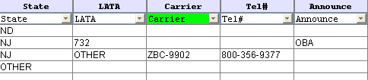
CPR – Other Carrier View
Data in Carrier and Tel# columns are not viewable by carrier 9902 as 9902 is not the carrier on the first 2 rows.
Notes:
CPR – Other Carrier View
(Click)
Carriers can access a CPR and view their routing (only their row(s)) for that CPR. i.e. If carrier ZBC-9902 accesses this CPR they will not be able to see the Carrier or destination number for the row where they are not listed.
(Click) (Click) (Click)

Slide 18
Create New CPR Data for a Customer
Determine what Criteria are to be used as Column headers in the CPR.
Put the Criteria (headers) in order from General (left) to specific (right). Decision on left. Action on right.
3. Enter any new Terminating Telephone numbers in the CAD.
4. Enter AOS (Area of Service) in the CAD.
5. Enter Carriers in the CAD .
6. Draw out your Call Routing Diagram (Tree).
7. Enter the data in the CPR.
8. Update and correct Errors until record status is Pending.
Notes:
To Create a NEW CPR, proceed with the following steps:
(Click)
Determine what Criteria are to be used as Column headers in the CPR.
(Click)
Put the Criteria (headers) in order from General (left) to specific (right). Decision on left. Action on right.
(Click)
Enter any new Terminating Telephone numbers in the CAD.
(Click)
Enter AOS (Area of Service) in the CAD.
(Click)
Enter Carriers in the CAD .
(Click)
Draw out your Call Routing Diagram (Tree).
(Click)
Enter the data in the CPR.
(Click)
Update and correct Errors until record status is Pending.
(Click)

Slide 19
Retrieve/Change Customer's CPR Data
Retrieve the CPR. (CAD must already exist)
< Type Dial# in Dial# field and press the Retrieve button>
2. If the CR is (Active, Sending or Disconnect) copy the record forward.
3. If viewing CAD, click on the CPR button.
4. Re-Draw your Call Routing Diagram (Tree).
5. Change or confirm Column Headers (drop down).
6. Type New Data into the Cells (fields) of the CPR table.
7. Change or Confirm the (Primary Carriers, Time Zone, Daylight Savings) fields.
8. Update the CPR. (Update actually Validates and Saves the Entire Customer Record – CAD, CPR and LAD)
9. Correct Errors and Update again. (Goal is to get a Pending record)
10. If you want the changes to be in active immediately, Transfer the entire CR to NOW and Update.
Notes:
If a CPR already exists for a customer record and the user wants to make changes follow these steps:
(Click)
Retrieve the CPR. (CAD must already exist)
< Type Dial# in Dial# field and press the Retrieve button>
(Click)
If the CR is (Active, Sending or Disconnect) copy the record forward.
(Click)
If viewing CAD, click on the CPR button.
(Click)
Re-Draw your Call Routing Diagram (Tree).
(Click)
Change or confirm Column Headers (drop down).
(Click)
Type New Data into the Cells (fields) of the CPR table.
(Click)
Change or Confirm the (Primary Carriers, Time Zone, Daylight Savings) fields.
(Click)
Update the CPR. (Update actually Validates and Saves the Entire Customer Record – CAD, CPR and LAD)
(Click)
Correct Errors and Update again. (Goal is to get a Pending record)
(Click)
10. If you want the changes to be in active immediately, Transfer the entire CR to NOW and Update.
Click)

Slide 20
Delete a Customer's Call Processing Data
CPR must be a future Eff. Date/Time.
Press the Delete button at the Bottom of the CPR window. (Be careful not to press the Delete button on the CAD)
Reply to the confirmation window. (Yes or No)
Notes:
To delete a CPR, the CPR must have a future Eff Date/Time.
(Click)
CPR must be a future Eff. Date/Time.
(Click)
1. Press the Delete button at the Bottom of the CPR window. (Be careful not to press the Delete button on the CAD as this could put the number back to Spare.)
(Click)
Reply to the confirmation window. (Yes or No)
(Click)

Slide 21
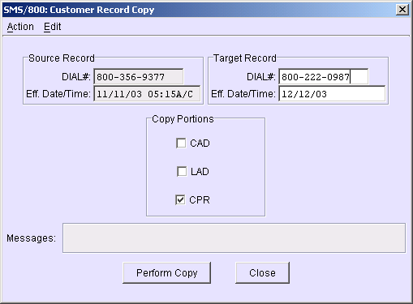
Copy Source CPR Record to a Different CR
From one of the Customer Record windows, click on the Copy button or press Ctrl+Y.
Confirm or change the Target Record DIAL# field.
Type the Eff. Date/Time for the new record.
Select only the CPR in the Copy Portions options.
Press the “Perform Copy” Button. (nearest CAD will be attached)
After viewing the newly created CR, save or update.
Notes:
To Copy a CPR to a Different Customer Record…
(Click)
1. From one of the Customer Record windows, click on the Copy button or press Ctrl+Y.
(Click)
2. Confirm or change the Target Record DIAL# field.
(Click)
3. Type the Eff. Date/Time for the new record.
(Click)
4. Select only the CPR in the Copy Portions options.
(Click)
5. Press the “Perform Copy” Button. (nearest CAD will be attached)
(Click)
6. After viewing the newly created CR, save or update.
(Click)

Slide 22
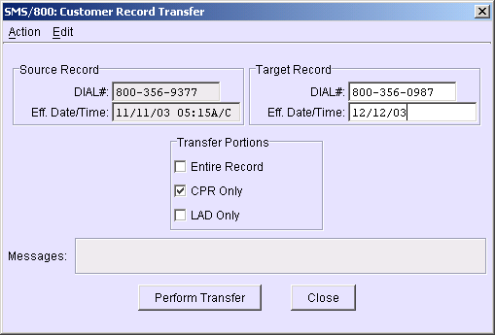
Transfer Source CPR Record to a Different CR
From one of the Customer Record windows, click on the Transfer button or Press Ctrl+T.
Confirm or change the Target Record DIAL# field.
Type the Eff. Date/Time for the new record.
Select the CPR Only in the Transfer Portions options.
Press the “Perform Transfer” Button.
After viewing the newly moved CR, save or update.
Notes:
To Transfer a CPR is like Cut and Paste. The original will no longer exist.
(Click)
1. From one of the Customer Record windows, click on the Transfer button or Press Ctrl+T.
(Click)
2. Confirm or change the Target Record DIAL# field.
(Click)
3. Type the Eff. Date/Time for the new record.
(Click)
4. Select the CPR Only in the Transfer Portions options.
(Click)
5. Press the “Perform Transfer” Button.
(Click)
6. After viewing the newly moved CR, save or update.
(Click)

Slide 23
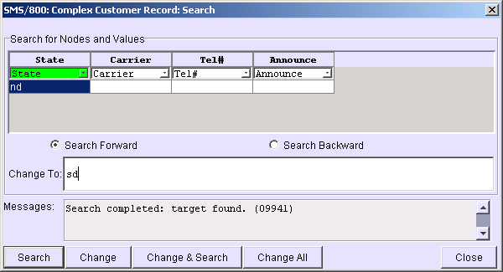

Searching a CPR
From the CPR window, press the Search Button.
In the Search window, type what you are looking for under the appropriate column.
Select the Search Button. Entry cell is highlighted in the CPR table.
User then has the option to change the entry by typing the new entry in the “Change To” field. (This enables the three change buttons)
ND
| |
SC
ND,FL,CA
Notes:
To use the Search feature for the CPR:
(Click)
1. From the CPR window, press the Search Button.
(Click) (Click)
2. In the Search window, type what you are looking for under the appropriate column.
(Click) (Click)
3. Select the Search Button. Entry is highlighted in the CPR table.
(Click)
4. User then has the option to change the entry by typing the new entry in the “Change To” field. (This enables the three change buttons)
(Click)

Slide 24
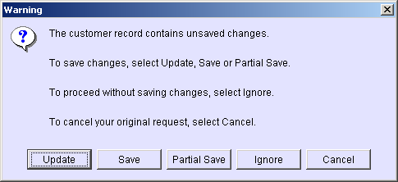
Warning (when closing CR)
If a CR has not been saved or updated since last changed, the following message will be displayed
Partial Save often
Notes:
If a CR has not been saved or updated since last changed, the following message will be displayed when attempting to close the record.
(Click)
If, for some reason, the CR cannot be Updated or Saved you will have to select Ignore. You will lose your current entries but have no choice.
(Click)
As you work do a Partial Save (check your messages for transaction Completed) to make sure you don’t do a lot of work only to have to ignore.
(Click)

Slide 25
CPR Example #01
Area of Service is US. Customer wants calls from SC, FL and CA to use 9901 as their carrier terminating at 701-222-3333.
All other states are to use 9902 as their carrier terminating at the Dial# turnaround.
Notes:
Let us build a Tree and CPR for Example #01

Slide 26
CPR Example #02
AOS is US. In South Carolina (SC), Area Code 803 use 9901
to 701-222-3333. All other Area Codes in SC, use 9902 to Dial# turnaround.
In Florida (FL), 8:00a – 5:00p use 9901 to Dial# turnaround. All other times in FL use 9902 to Dial# turnaround.
All other States use 9902 to the Dial# turnaround.
Notes:
Let us build a Tree and CPR for Example #02

Slide 27
CPR Example #03
AOS is US. Calls from LATA 638 are to be divided equally between carriers 9901 and 9902. Carrier 9901 will terminate at 701-222-3333. 9902 will terminate at the Dial# turnaround.
Calls from LATA 534 on Christmas and New Years Day are to use carrier 9901 to 701-222-3333. On all other dates of the year 9902 will carry calls to the Dial# turnaround.
All other LATAs are to use 9902 to the Dial# turnaround.
Notes:
Let us build a Tree and CPR for Example #03

Slide 28
CPR Example #04
AOS is US. Calls from 701-223-1234 in Area Code 701 are to be blocked. All other calls from 701 will use 9901 to Dial# turnaround.
Calls from 703 will use 9902 to 701-222-3333. Calls from the Six-digit number 702-222 will use 9902 to 701-222-3333. All other calls from 702 will be blocked.
Calls from all other Area Codes will use 9901 to the Dial#.
Notes:
Let us build a Tree and CPR for Example #04

Slide 29
CPR Example #05
AOS is Fl and MS. All calls originating in Florida will be routed to Atlanta. These calls will go through carrier 9901 to 404-222-5200.
Calls originating in Mississippi will normally be routed to New Orleans, as follows:
25% of the calls should go through carrier 9902 to 504-656-1700.
25% of the calls should go through carrier 9903 to the Dial# turnaround.
50% of the calls should go through carrier 9901 to 504-656-1000 on Monday through Friday. On weekends, these calls should go through carrier 9904 to 504-656-1532.
If the New Orleans office phones are shut down for some reason, calls originating in MS will be routed to Atlanta via carrier 9901 to 404-222-5000.
Notes:
Let us just review this complex record. Take notice of the use of “Suffix”.

Slide 30
CPR Example #01
Area of Service is US. Customer wants calls from SC, FL and CA to use 9901 as their carrier terminating at 701-222-3333.
All other states are to use 9902 as their carrier terminating at the Dial# turnaround.
STATE
SC,FL,CA
OTHER
CARRIER
9901
9902
TEL#
701-222-3333
888-266-7539
Notes:
Example 1 Tree

Slide 31
CPR Example #01
Area of Service is US. Customer wants calls from SC, FL and CA to use 9901 as their carrier terminating at 701-222-3333.
All other states are to use 9902 as their carrier terminating at the Dial# turnaround.
Notes:
Example 1 CPR

Slide 32
CPR Example #02
AOS is US. In South Carolina (SC), Area Code 803 use 9901 to 701-222-3333. All other Area Codes in SC, use 9902 to Dial# turnaround.
In Florida (FL), 8-5 use 9901 to Dial# turnaround. All other times in FL use 9902 to Dial# turnaround.
All other States use 9902 to the Dial# turnaround.
STATE
SC
FL
OTHER
AREA CODE
803
OTHER
TIME
8:00A-5:00P
OTHER
CARRIER
9901
9902
9901
9902
9902
TEL#
701-222…
Dial#
Dial#
Dial#
Dial#
Notes:
Example 2 Tree

Slide 33
CPR Example #02
AOS is US. In South Carolina (SC), Area Code 803 use 9901 to 701-222-3333. All other Area Codes in SC, use 9902 to Dial# turnaround.
In Florida (FL), 8-5 use 9901 to Dial# turnaround. All other times in FL use 9902 to Dial# turnaround.
All other States use 9902 to the Dial# turnaround.
Notes:
Example 2 CPR

Slide 34
CPR Example #03
AOS is US. Calls from LATA 638 are to be divided equally between carriers 9901 and 9902. Carrier 9901 will terminate at 701-222-3333. 9902 will terminate at the Dial# turnaround.
Calls from LATA 534 on Christmas and New Years Day are to use carrier 9901 to 701-222-3333. On all other dates of the year 9902 will carry calls to the Dial# turnaround.
All other LATAs are to use 9902 to the Dial# turnaround.
Lata
638
534
Other
%
50%
50%
12/25,1/1
Other
Date
Carr
9901
9902
9901
9902
9902
Tel#
701…
Dial#
701…
Dial#
Dial#
Notes:
Example 3 Tree

Slide 35
CPR Example #03
AOS is US. Calls from LATA 638 are to be divided equally between carriers 9901 and 9902. Carrier 9901 will terminate at 701-222-3333. 9902 will terminate at the Dial# turnaround.
Calls from LATA 534 on Christmas and New Years Day are to use carrier 9901 to 701-222-3333. On all other dates of the year 9902 will carry calls to the Dial# turnaround.
All other LATAs are to use 9902 to the Dial# turnaround.
Notes:
Example 3 CPR

Slide 36
CPR Example #04
AOS is US. Calls from 701-223-1234 in Area Code 701 are to be blocked. All other calls from 701 will use 9901 to Dial# turnaround.
Calls from 703 will use 9902 to 701-222-3333. Calls from the Six-digit number 702-222 will use 9902 to 701-222-3333. All other calls from 702 will be blocked.
Calls from all other Area Codes will use 9901 to the Dial#.
AreaCD
701
703
702
Other
6#
701-
Other
702-222
Other
10#
Carr
9901
9902
9902
9901
Tel#
Dial#
701…
701…
Dial#
Ann
OBA
OBA
Notes:
Example 4 Tree

Slide 37
CPR Example #04
AOS is US. Calls from 701-223-1234 in Area Code 701 are to be blocked. All other calls from 701 will use 9901 to Dial# turnaround.
Calls from 703 will use 9902 to 701-222-3333. Calls from the Six-digit number 702-222 will use 9902 to 701-222-3333. All other calls from 702 will be blocked.
Calls from all other Area Codes will use 9901 to the Dial#.
Notes:
Example 4 CPR

Slide 38
CPR Tree for Example #5
Suffix will link “like branches”
Notes:
Example 5 Tree.
Suffix will link like branches
(Click)
These 4 branches are linked under a single ON. Linked with a Numeric character
(Click)
These 2 branches are linked under a single 50%. Linked with an Alpha character.

Slide 39
CPR for Example #5
AOS is FL and MS. All calls originating in Florida will be routed to Atlanta. These calls will go through carrier 9901 to 404-222-5200.
Calls originating in Mississippi will normally be routed to New Orleans, as follows:
25% of the calls should go through carrier 9902 to 504-656-1700.
25% of the calls should go through carrier 9903 to the Dial# turnaround.
50% of the calls should go through carrier 9901 to 504-656-1000 on Monday through Friday. On weekends, these calls should go through carrier 9904 to 504-656-1532.
If the New Orleans office phones are shut down for some reason, calls originating in MS will be routed to Atlanta via carrier 9901 to 404-222-5000.
Suffix will link “Like branches” Decision entries to right
Notes:
Example 5 Tree.
Suffix will link like branches
(Click)
These 4 branches are linked under a single ON. Linked with a Numeric character ON1
(Click)
These 2 branches are linked under a single 50%. Linked with an Alpha character 50A.

Slide 40
CPR Review
CPR Definition
CPR General Rules
CPR window fields and buttons
Creating a new CPR
Changing a CPR
Copy and Transfer of a CPR
Search Feature
CPR Tree
Written Exercise CPR #4
Hands-On Exercises CPR (4A-4E)
Notes:
Please complete the Written and Hands On Exercises for Module 4 - CPR

